Slide 1

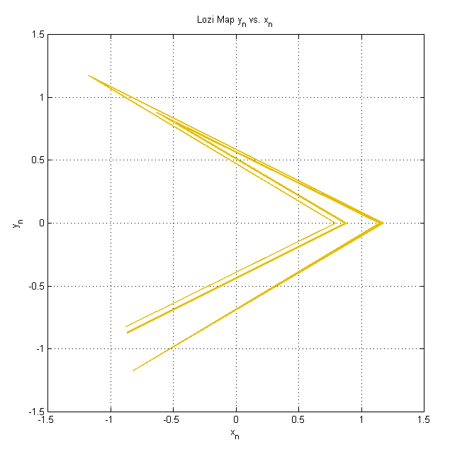
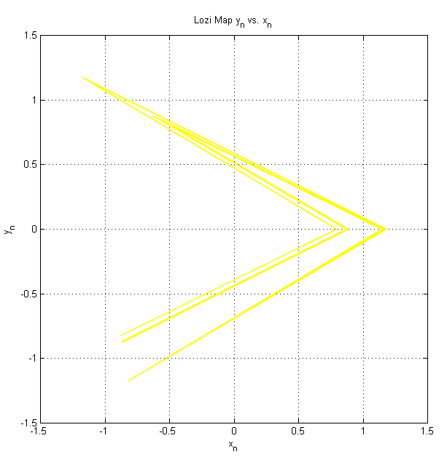
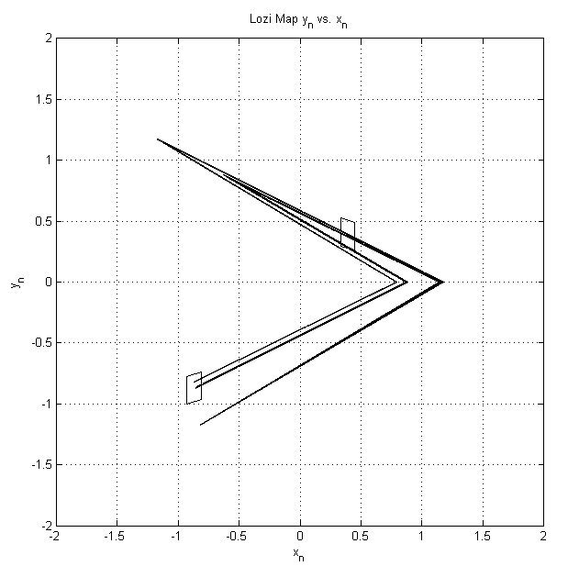
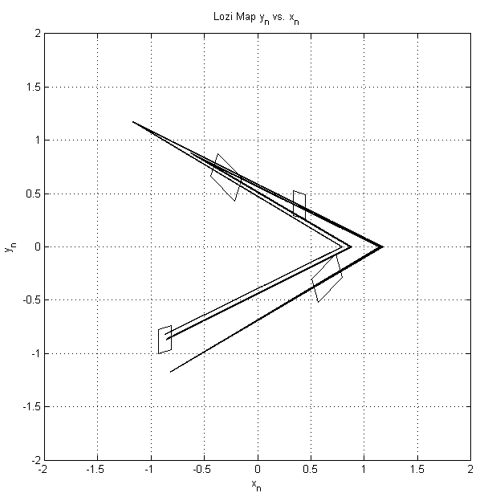
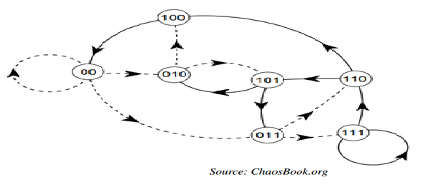
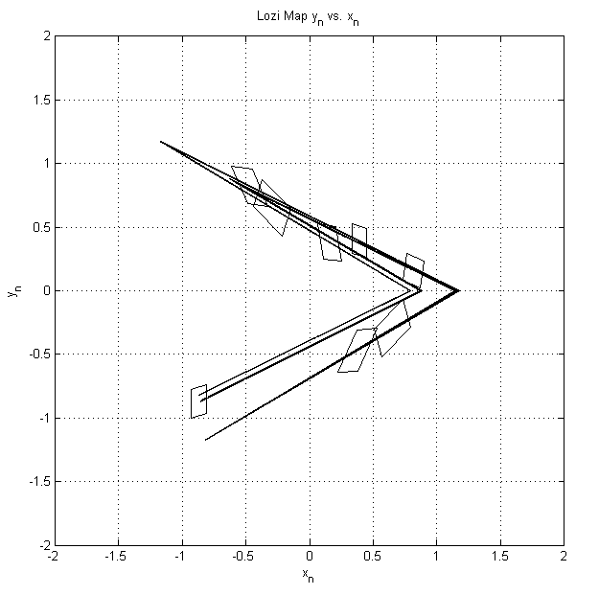
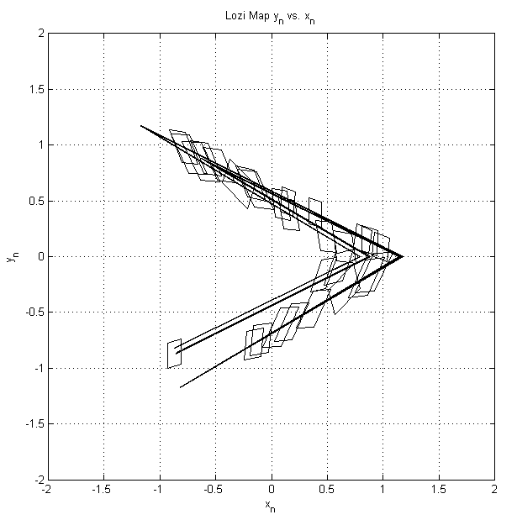
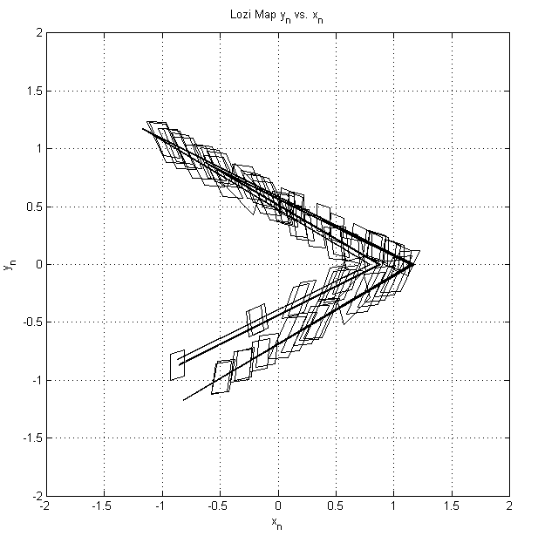
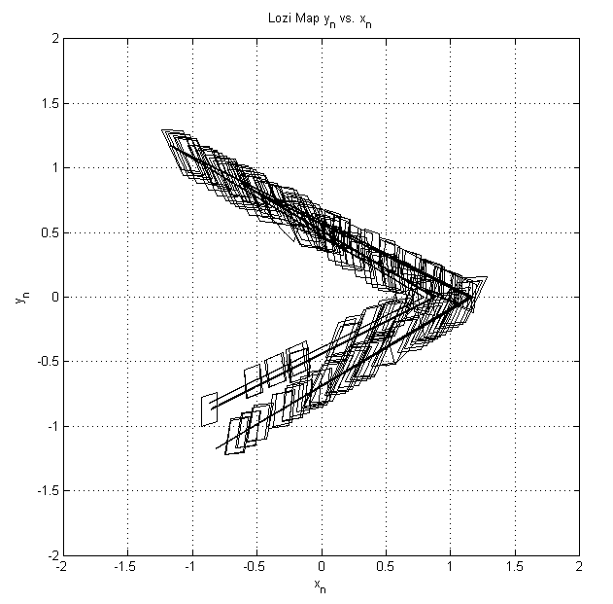
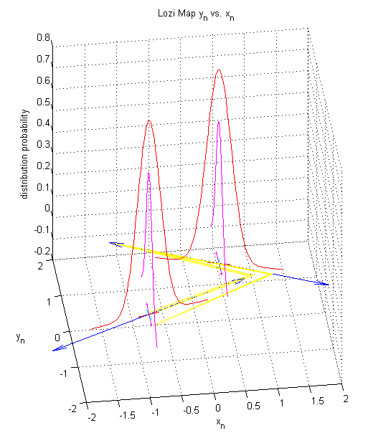
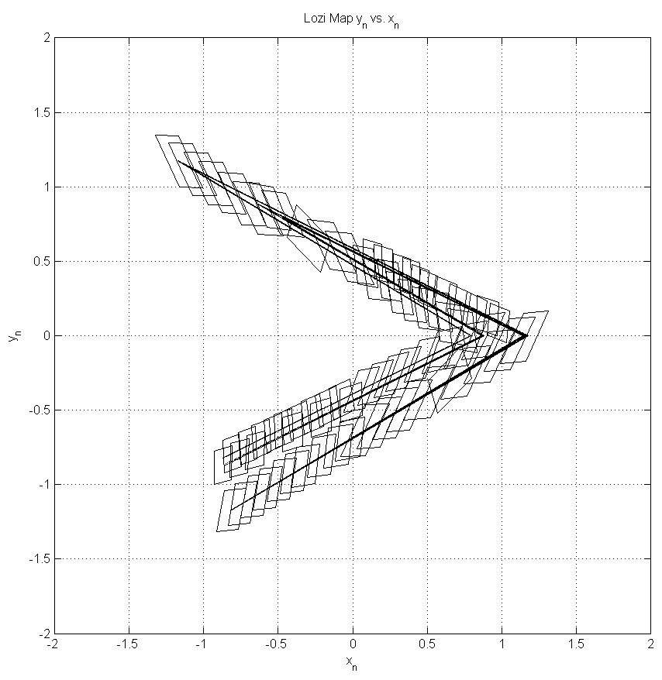


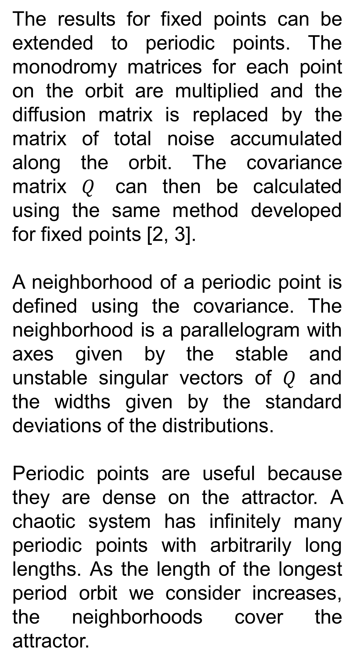
Resolving the State Space of Noisy Chaotic Maps
Jeffrey Heninger¹, Predrag Cvitanović¹, Domenico Lippolis²
¹ Center for Nonlinear Science, School of Physics, Georgia Institute of Technology, Atlanta, GA 30332-0430, USA
² Institute for Advanced Studies, Tsinghua University, Haidian, Beijing, China
LOZI MAP
NEIGHBORHOODS OF PERIODIC POINTS
MARKOV GRAPH
We have developed general techniques that work with any chaotic system with noise, described by a diffusion matrix Δ. We apply our techniques to the Lozi map, defined by:
$$x_{n+1}=1 −a \left|x_{n}\right|+b y_{n}$$
$$y_{n+1}=x_{n}$$
For almost any initial condition, the long time orbit is dense on the attractor shown in Figure 1. We use$a=1.85, b=0.3, Δ=0.01 I.$
Once we have our optimum partition, we no longer have to deal with the chaotic orbits directly. Instead, the dynamics can be described in terms of the probabilities that a point in one neighborhood will be mapping into another. Each neighborhood is described as a node of the graph. The transition probabilities are encoded in a matrix.
The results for fixed points can be extended to periodic points. The monodromy matrices for each point on the orbit are multiplied and the diffusion matrix is replaced by the matrix of total noise accumulated along the orbit. The covariance matrix $Q$ can then be calculated using the same method developed for fixed points [2, 3].
A neighborhood of a periodic point is defined using the covariance. The neighborhood is a parallelogram with axes given by the stable and unstable singular vectors of $Q$ and the widths given by the standard deviations of the distributions.
Periodic points are useful because they are dense on the attractor. A chaotic system has infinitely many periodic points with arbitrarily long lengths. As the length of the longest period orbit we consider increases, the neighborhoods cover the attractor.
(1)
Figure 1: The attractor of the
Lozi map. All orbits eventually converge to this fractal set.
STATIONARY DISTRIBUTIONS NEAR FIXED POINTS
Near an entirely stable or unstable fixed point, there is a Gaussian distribution which is stationary under the combined action of the noise and the linearized dynamics, described by the monodromy matrix $M$ [2, 3]. The Gaussian’s covariance matrix $Q$ is found by solving the Lyapunov equation or its adjoint [4].
$$Q=M Q M^{⊤}+ Δ, M Q M^{⊤}=Q+ Δ$$
The solution to either of these equations is given by the integral.
$$Q=\oint{\frac{ds}{2 π i}} \frac{1}{1 − e^{s}M} ∆ \frac{1}{1 − e^{s}M^{⊤}}$$
Since this integral doesn’t care about the stability of the point, it defines the covariance for when the point has both stable and unstable directions. It is equivalent to changing variables so the stable and unstable directions are separated and then solving each Lyapunov equation independently.
Figure 5: A Markov graph between neighborhoods labeled by their
symbolic dynamics. [1]
GLOBAL STATIONARY DISTRIBUTION
The leading eigenvector of the transition matrix, with eigenvalue one, is the global stationary distribution. Any initial distribution converges to this at a rate given by the second eigenvalue. Long time averages of observables can be calculated using this distribution. In future work, we will find this eigenvector and use it to calculate the Lyapunov exponents of the Lozi map. This will be used to check our method.
(2)
(3)
Figure 3: The neighborhoods of all periodic points of the Lozi map of periods up to 1, 2, 4, 5, 6, and 7. There are no period 3 points.
CONCLUSIONS
Long time observables for chaotic systems cannot be calculated directly using individual trajectories. Instead, the state space is partitioned and the observables are calculated using the matrix of probabilities for transitions between elements of the partition. We offer a new technique for forming the optimum partition for a system with both stable and unstable directions. All physical systems have some inherent noise which limits the finest observable resolution. We use the competition between this noise and the dynamics to define neighborhoods of periodic points and use these neighborhoods to partition the state space. We apply this technique to the Lozi map, a two dimensional chaotic system in discrete time.
OPTIMUM PARTITION
We want to completely cover the attractor with neighborhoods that overlap by no more than 50%. As we increase the period, we add new points to the optimum partition only if they do not overlap with any neighborhoods of shorter period. If neighborhoods of the same period overlap, we remove some until there is no overlap. We choose the technique for removing points so the resulting neighborhoods cover the maximum area of the state space. Once the attractor is completely covered, the set of neighborhoods is the optimum partition of the state space.
REFERENCES
[1] P. Cvitanovic, R. Artuso, R. Mainieri, G. Tanner, and G. Vattay. Chaos: Classical and Quantum. Niels Bohr Institute, Copenhagen, 2013.
[2] P. Cvitanovic and D. Lippolis. Knowing when to stop: How noise frees us from determinism. In M. Robnik and V. G. Romanovski, editors, Let's Face Chaos through Nonlinear Dynamics, pages 82-126, Melville, New York, 2012. Am. Inst. of Phys.
[3] D. Lippolis. How well can one resolve the state space of a chaotic map? PhD thesis, School of Physics, Georgia Inst. of Technology, Atlanta, 2010.
[4] A. M. Lyapunov. The general problem of the stability of motion. Int. J. Control, 55:531-534, 1992.
Figure 2: Stationary distributions near the fixed points of the Lozi map.
Figure 4: Optimum partition of the Lozi map.

